Slide 1


Last Interglacial (LIG) sea level:
Ice Cores and Emulation?
Louise C. Sime, Jochen Voss; Fiona Turner; Dario Domingo; Irene Malmierca; Max Holloway; Richard Wilkinson
British Antarctic Survey, Cambridge, CB3 0ET, U.K.,
University of Leeds, Leeds, UK.
University of Sheffield, Sheffield, UK.

Slide 2
Outline:
Using the past to constrain future global sea level (GSL) change.
Polar ice cores: well dated evidence of GSL changes?
Applying emulator-based techniques.
Future work.

Slide 3
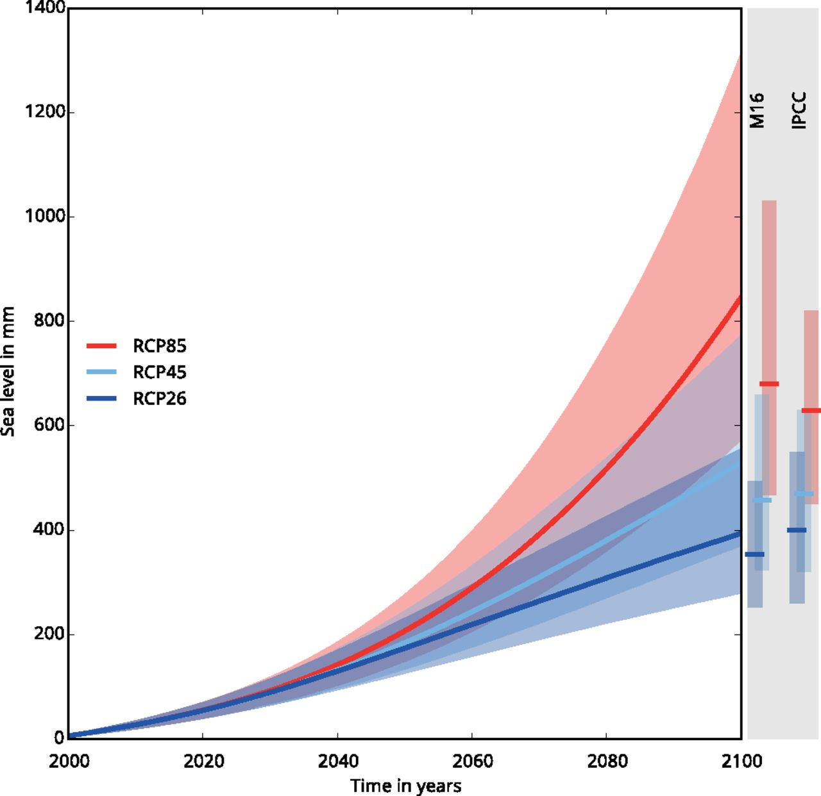
Projected total anthropogenic sea level rise for the 21st century.
Matthias Mengel et al. PNAS 2016;113:2597-2602
©2016 by National Academy of Sciences
Notes:
Projected total anthropogenic sea level rise for the 21st century. Median (thick line) and fifth to 95th percentile uncertainty range (shading) of projected total anthropogenic sea level rise for three RCP scenarios as the sum of the single projected contributions (Fig. 2). Bars at the right show fifth to 95th percentile range of this study (M16) and the IPCC AR5 (3) likely ranges intersected by the median for 2081–2100. All are relative to the 1986–2005 mean.

Slide 4
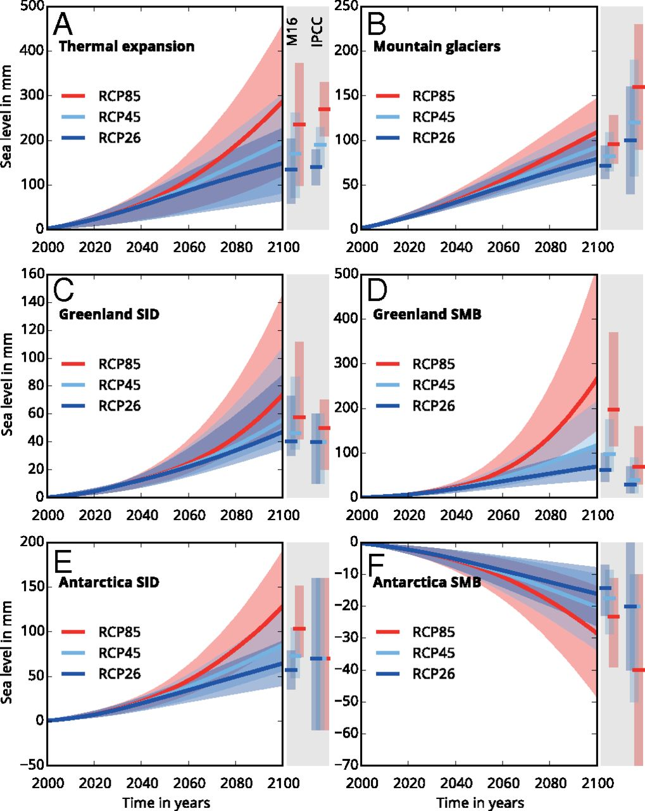
Projected contributions to 21st century sea level rise.
Matthias Mengel et al. PNAS 2016;113:2597-2602
©2016 by National Academy of Sciences
Notes:
Projected contributions to 21st century sea level rise for thermal expansion (A), mountain glaciers (B), Greenland solid ice discharge (C) and surface mass balance (D), and Antarctic solid ice discharge (E) and surface mass balance (F). Median (thick line) and fifth to 95th percentile uncertainty range (shading) of projected single contributions for the three RCP scenarios; based on 10,000 individual sea level curves. Bars at the right show fifth to 95th percentile range of this study (M16) and the IPCC AR5 (3) likely ranges intersected by the median for the 2081–2100 time mean. All are relative to the 1986–2005 mean. The y axis scale varies between panels.

Slide 5
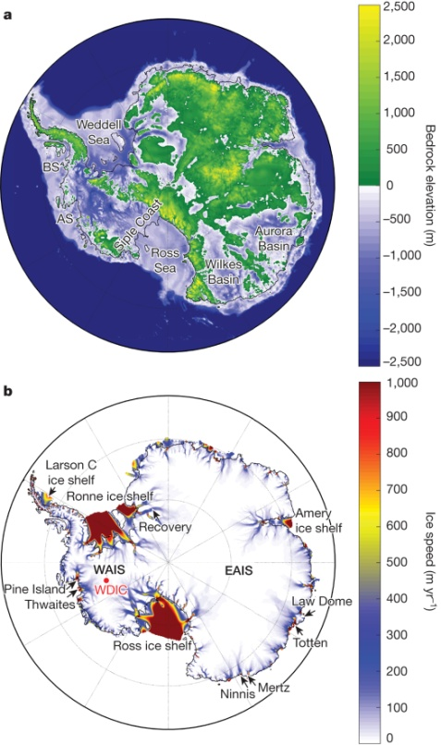
The West Antarctic Ice Sheet (WAIS) is currently losing mass:
Complete collapse of present day WAIS could add >6m to sea level:
Pritchard et al, Nature 2012

Slide 6
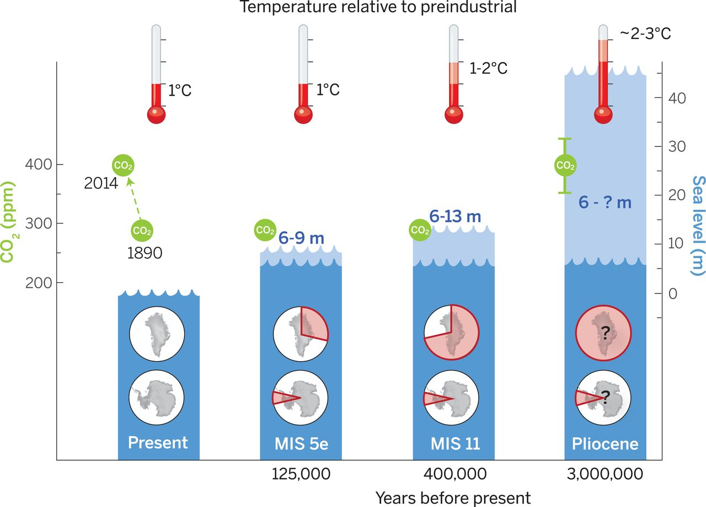

Long term global mean sea level (GMSL) changes and source(s) of meltwater.
A. Dutton et al. Science 2015;349:aaa4019
Published by AAAS
Notes:
Peak global mean temperature, atmospheric CO₂, maximum global mean sea level (GMSL), and source(s) of meltwater. Light blue shading indicates uncertainty of GMSL maximum. Red pie charts over Greenland and Antarctica denote fraction (not location) of ice retreat.

Slide 7
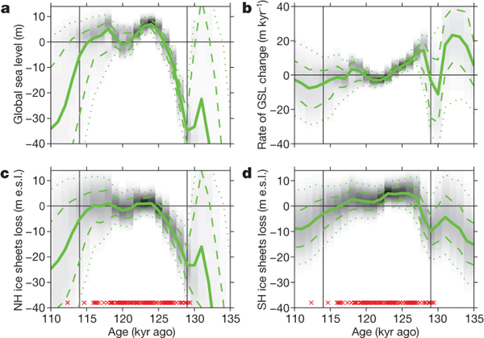
Timing and rates: Probability density plots of GSL and ice volume during the LIG.
RE Kopp et al. Nature 462, 863-867 (2009) doi:10.1038/nature08686

Slide 8
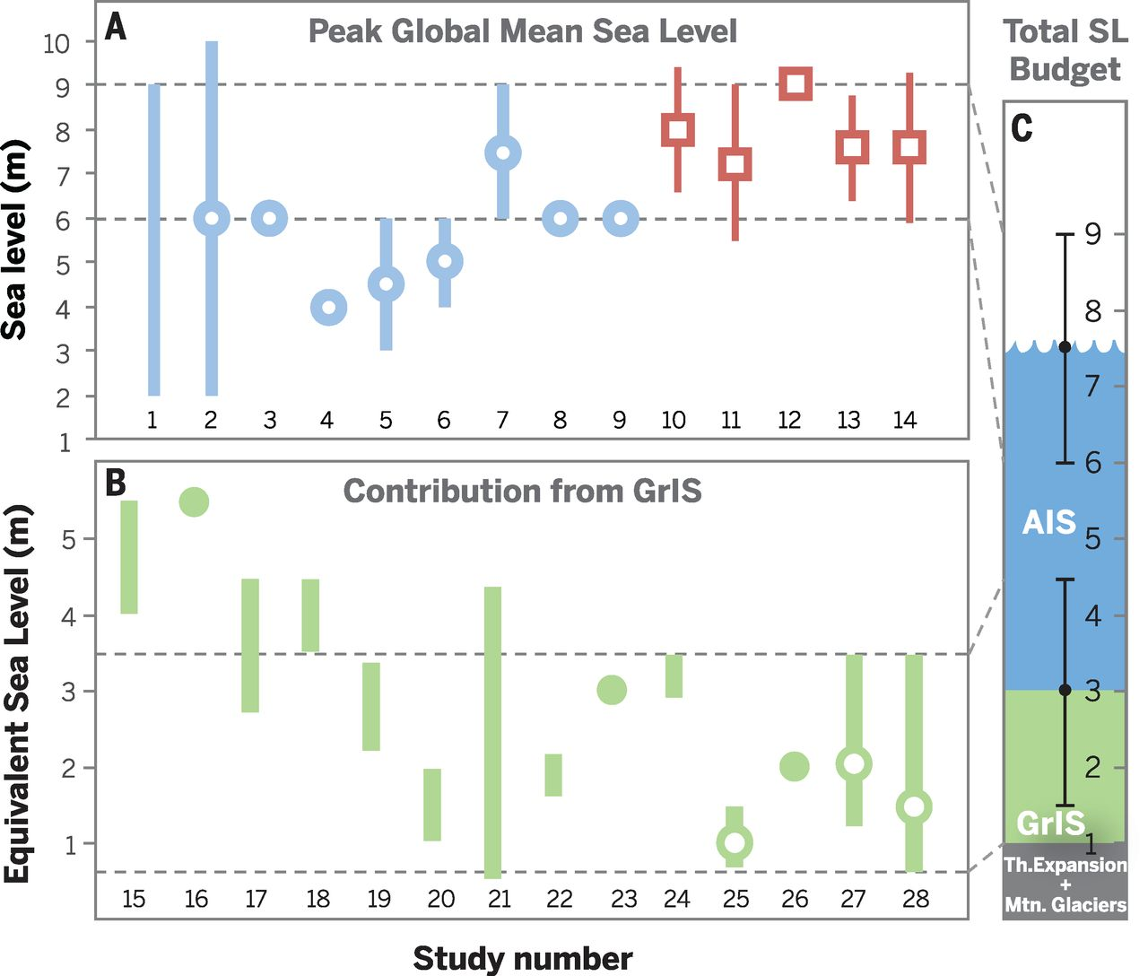
Compilation of LIG reconstructions for peak GMSL and GrIS contribution.
A. Dutton et al. Science 2015;349:aaa4019
Published by AAAS
Notes:
Compilation of MIS 5e reconstructions for peak GMSL, GrIS contribution, and best estimate of the total sea level budget. Estimates of (A) peak MIS 5e GMSL and (B) meltwater contribution from the GrIS shown in chronological order of time of publication from left to right. Ranges indicated by vertical bars; point estimates and best estimates within ranges shown as circles. GIA-corrected records are shown in red squares. Horizontal dashed lines denote range of agreement between recent studies. (C) Total sea-level budget of MIS 5e, shown with estimated uncertainty for each component. One meter is attributed to thermal expansion and loss of mountain glaciers (gray shading). As the estimate of GrIS (green shading) has decreased, the overall peak GMSL estimate has grown, leading to increased confidence of a more substantial contribution from the AIS (blue shading). Data sources are listed in table S2.

Slide 9
Data sources for previous figure (lots of studies!):
1 Veeh 1966 (132)
2 Chappell and Shackleton 1986 (133)
3 Chen et al. 1991 (72)
4 Stirling et al. 1998 (57)
5 Muhs et al. 2002a (134)
6 Muhs et al. 2002b (135)
7 Hearty et al. 2007 (73)
8 Blanchon et al. 2009 (71)
9 Thompson et al. 2011 (74)
10 Kopp et al. 2009 (62)
11 Dutton and Lambeck 2012 (61)
12 O'Leary et al. 2013 (64)
13 Kopp et al. 2013 (77)
14 Dutton et al. 2015 (63)
15 Cuffey and Marshall 2000 (136)
16 Huybrechts 2002 (137)
17 Tarasov and Peltier 2003 (138)
18 L'homme et al. 2005 (139)
19 Otto-Bleisner et al. 2006 (140)
20 Oerlemans et al. 2006 (141)
21 Robinson et al. 2011 (142)
22 Colville et al. 2011 (67)
23 Fyke et al. 2011 (143)
24 Born and Nisancioglu 2012 (144)
25 Quiquet et al. 2013 (145)
26 Dahl-Jensen et al. 2013 (60)
27 Helsen et al. 2013 (146)
28 Stone et al. 2013 (147)

Slide 10
Ice sheet model physics: Antarctic sub-glacial topography and ice sheet features:
R M DeConto et al. Nature 531, 591–597 (2016) doi:10.1038/nature17145

Slide 11
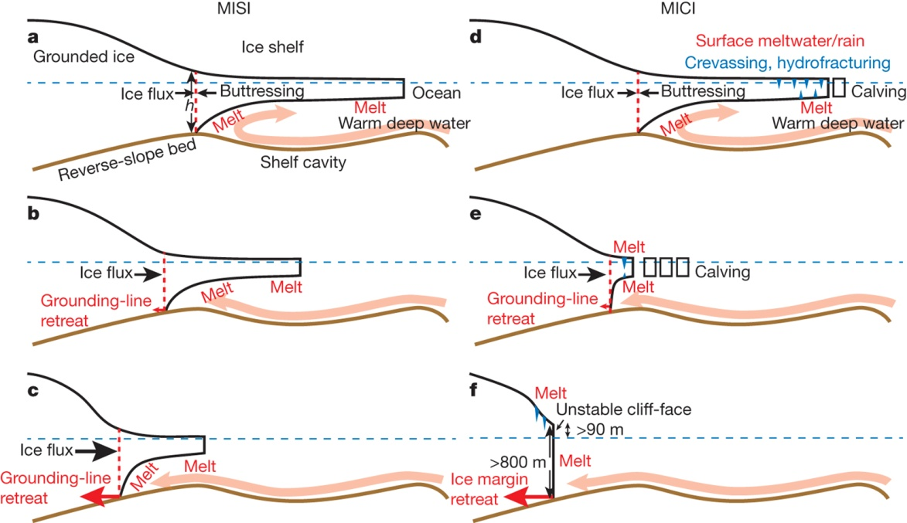
Ice sheet model physics: Hypothesised MISI and MICI processes:
R M DeConto et al. Nature 531, 591–597 (2016) doi:10.1038/nature17145

Slide 12
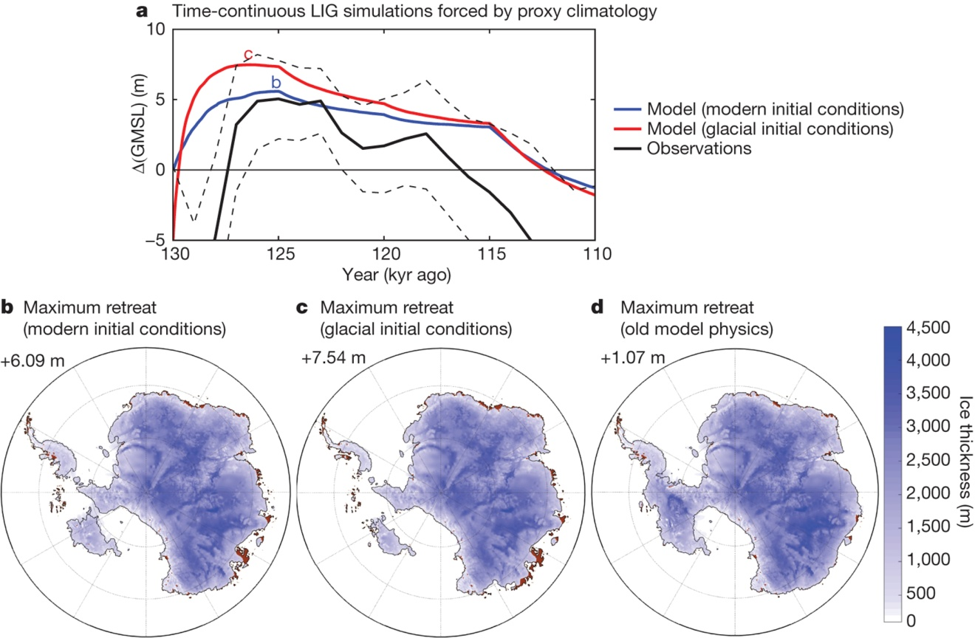
Ice-sheet simulations and Antarctic contributions to GMSL through the LIG driven by a time-evolving, proxy-based atmosphere–ocean climatology
R M DeConto et al. Nature 531, 591–597 (2016) doi:10.1038/nature17145

Slide 13
Timing and rates: Probability density plots of GSL and ice volume during the LIG.
RE Kopp et al. Nature 462, 863-867 (2009) doi:10.1038/nature08686

Slide 14
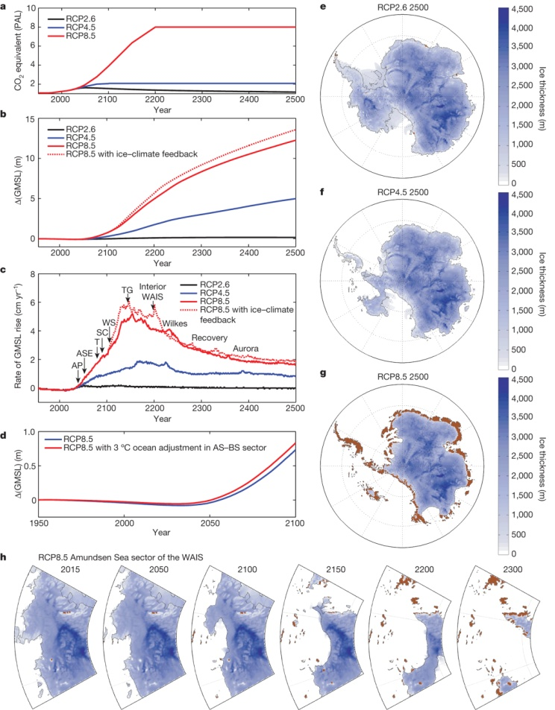
Constraining future ice-sheet simulations and Antarctic contributions to GMSL…
R M DeConto et al. Nature 531, 591–597 (2016) doi:10.1038/nature17145

Slide 15
Outline:
Using the past to constrain future global sea level (GSL) change.
Polar ice cores: well dated evidence of GSL changes?
Applying emulator-based techniques.
Future work.

Slide 16
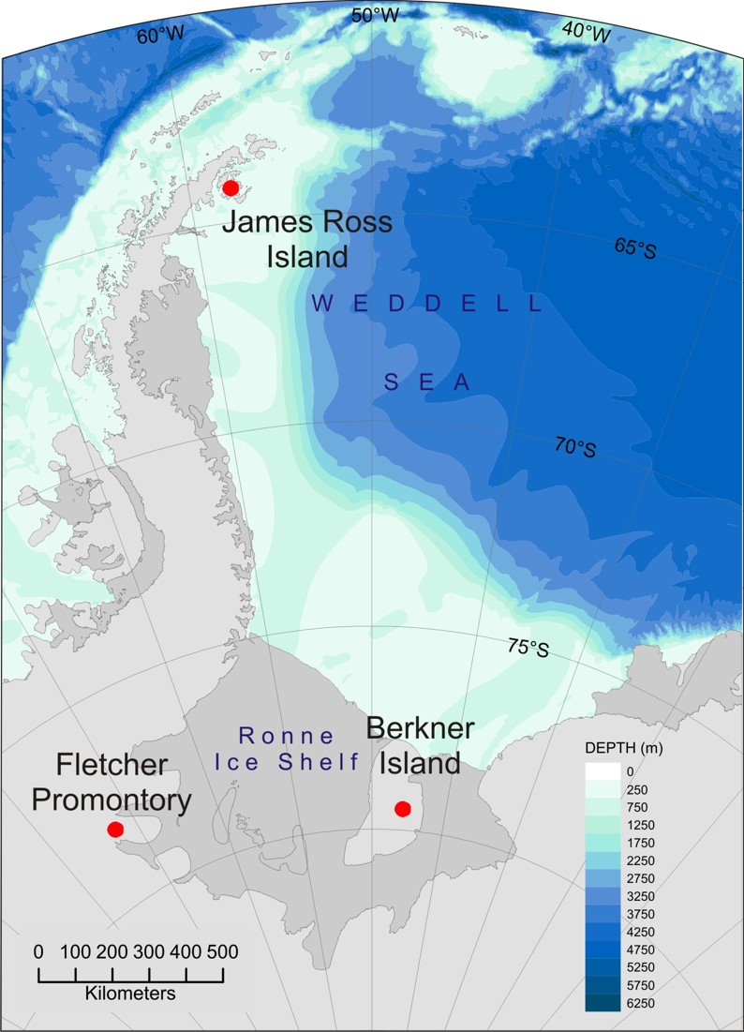
Weddell Sea ice cores – the UK deep ice core drilling projects:

Slide 17
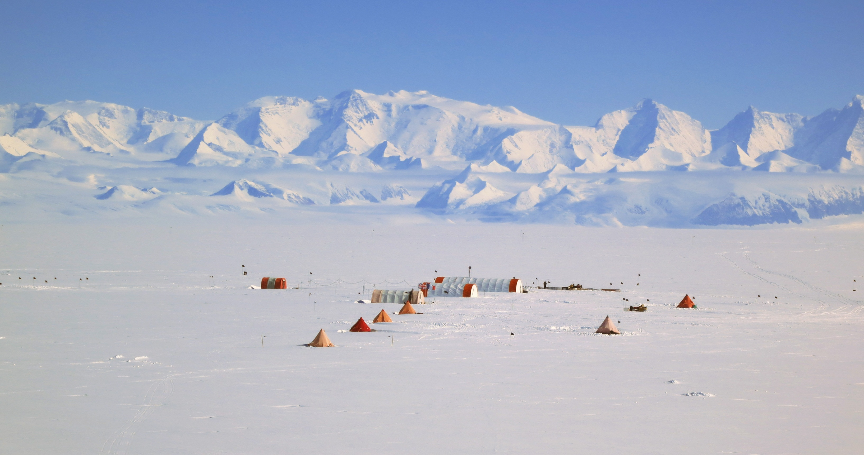


Slide 18
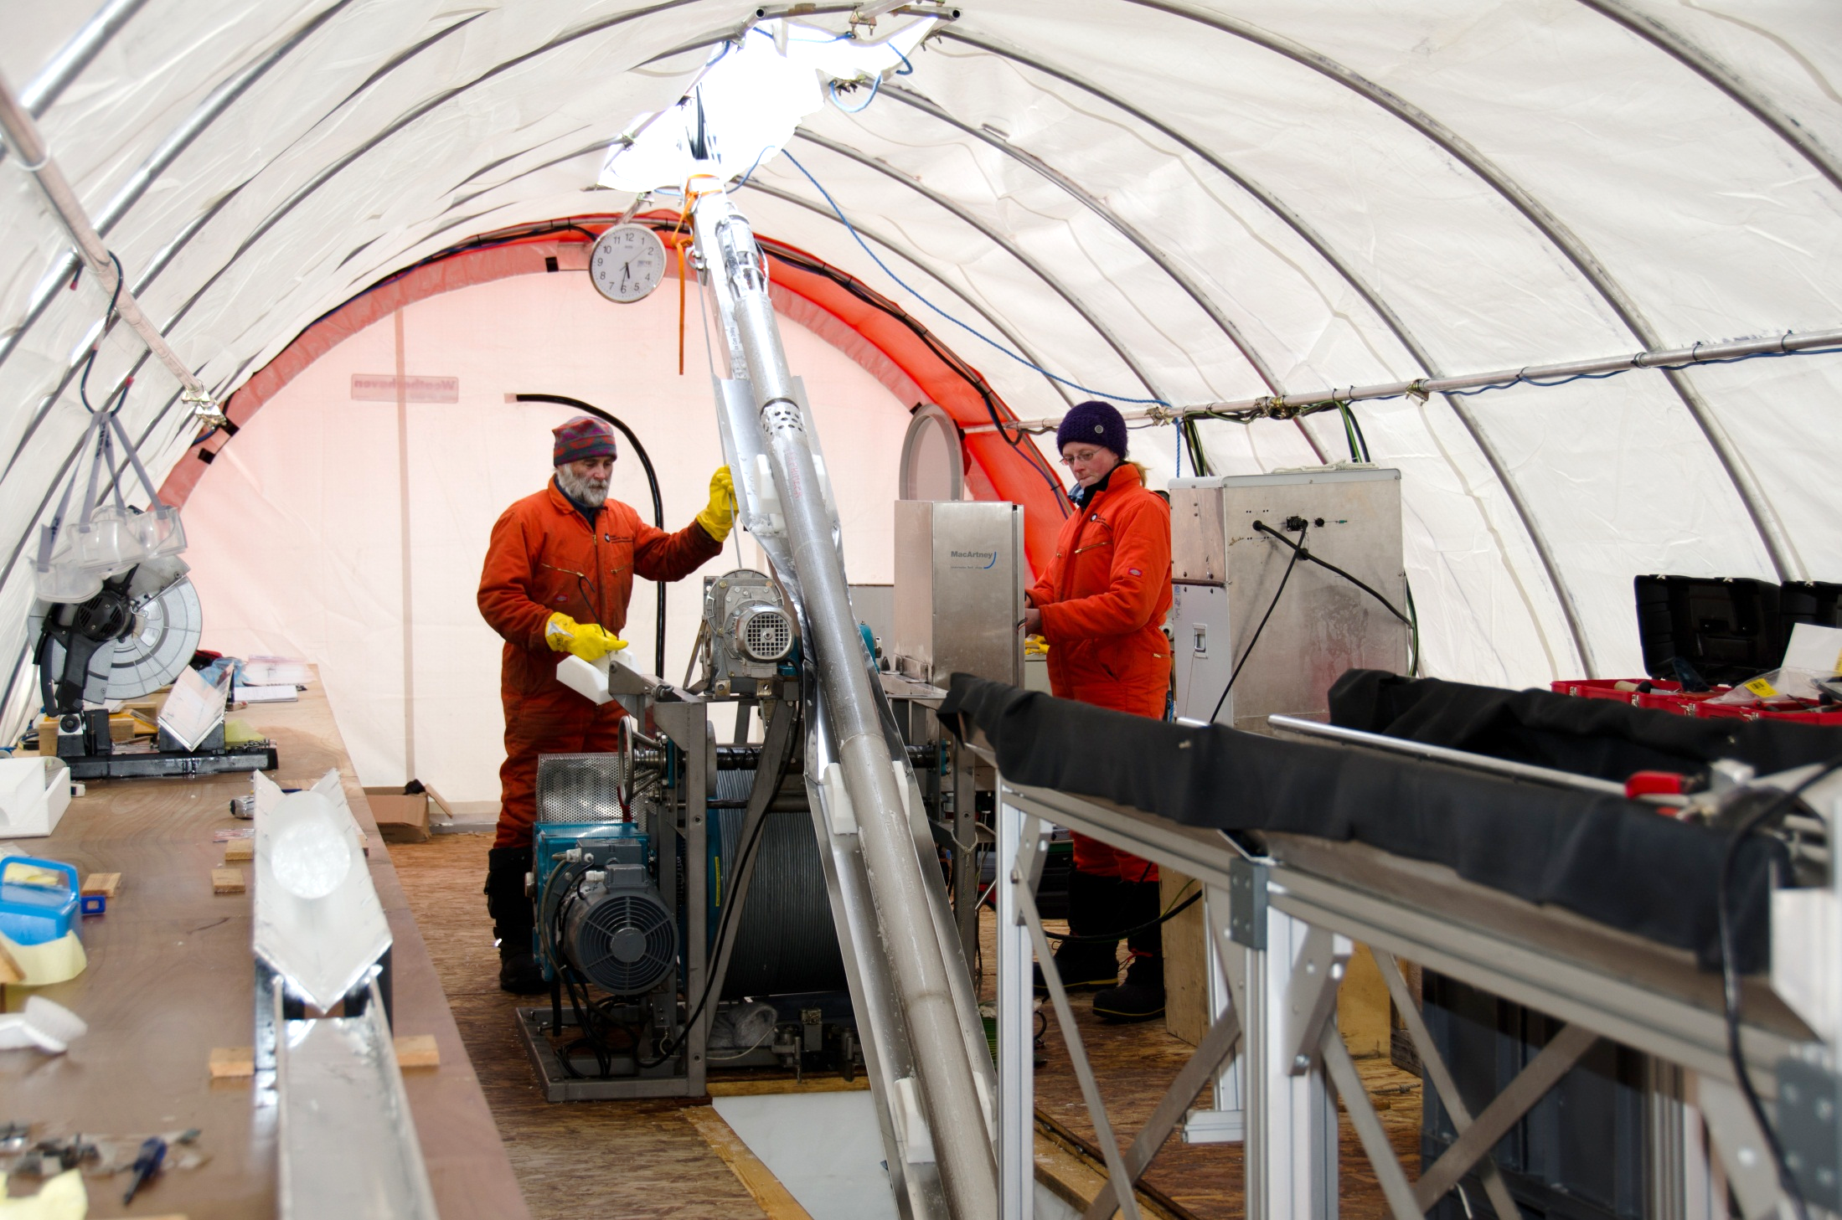

Slide 19
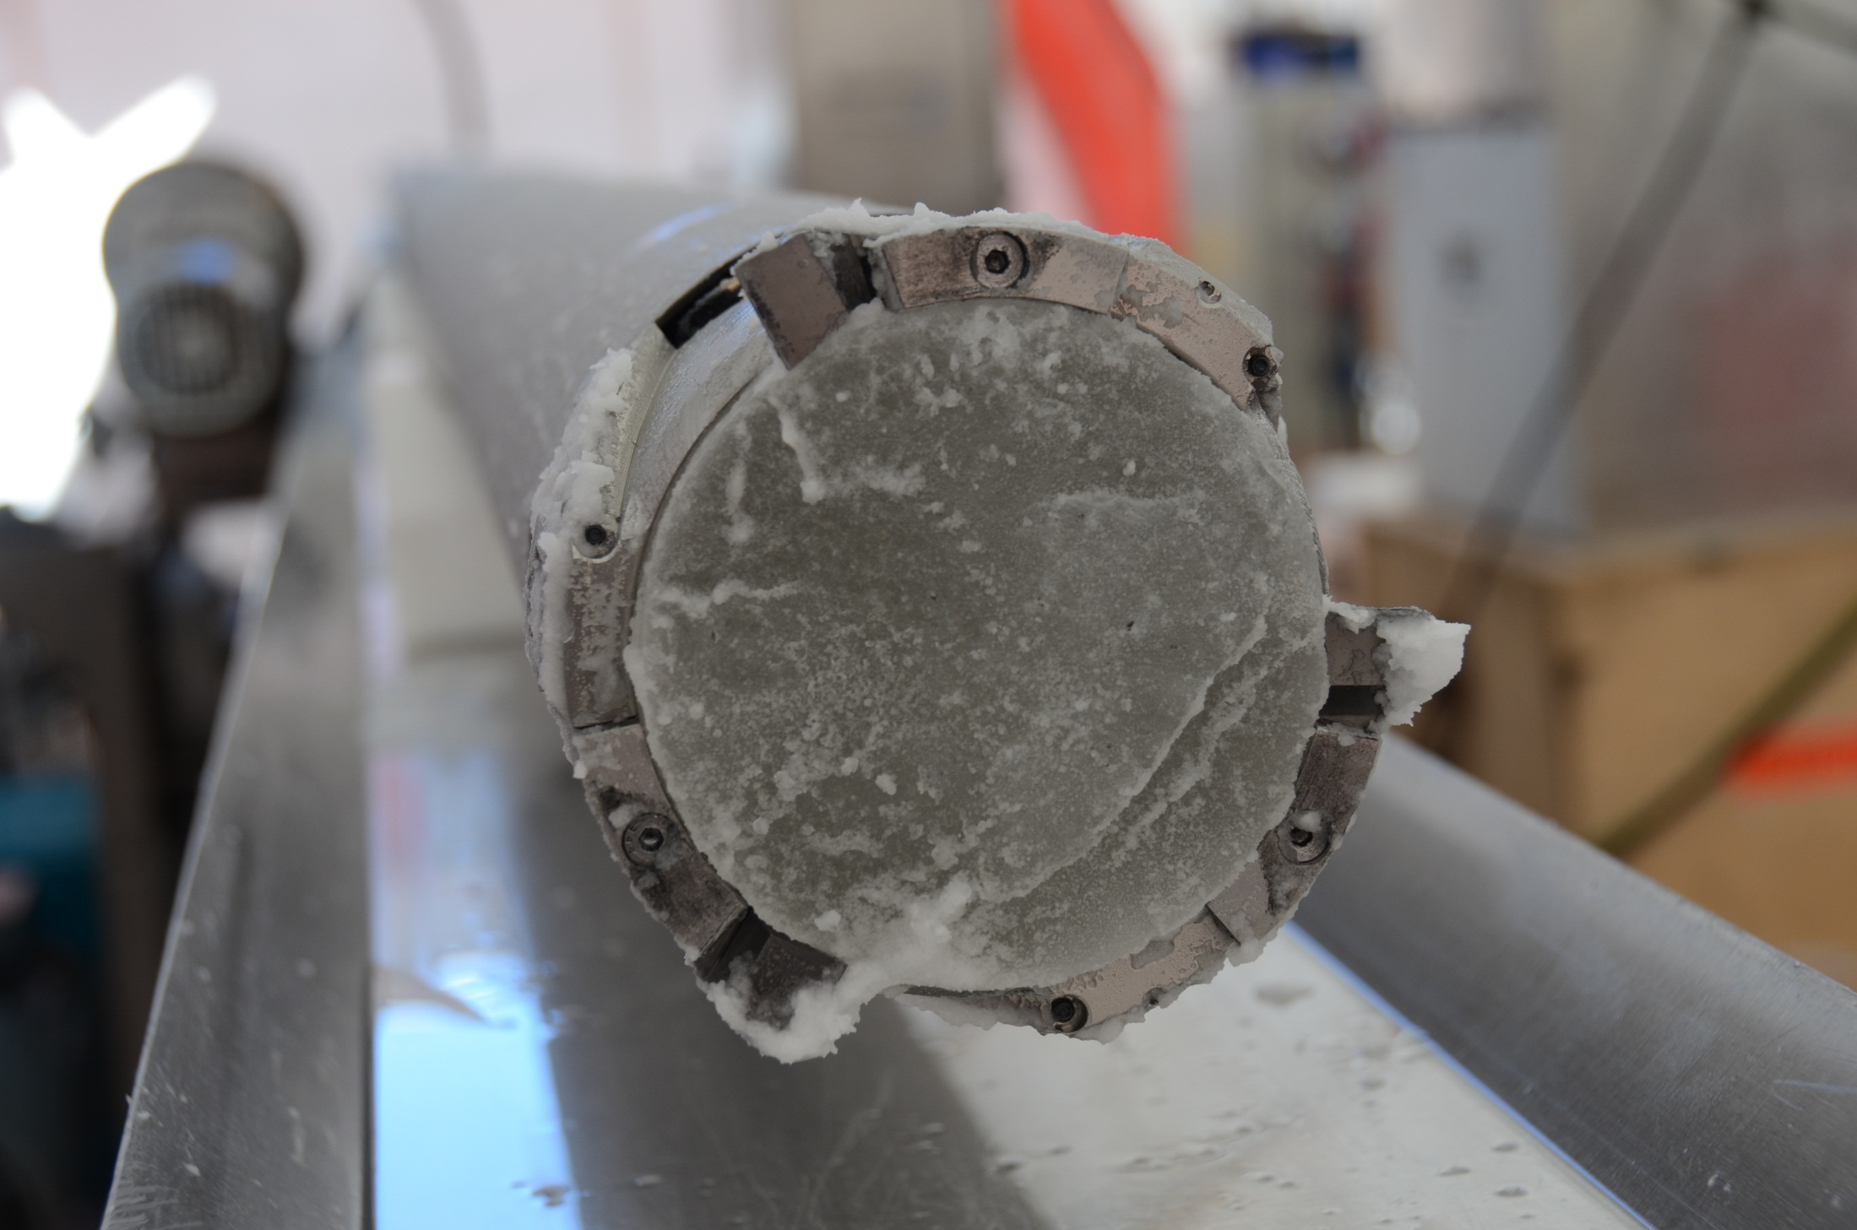

Slide 20
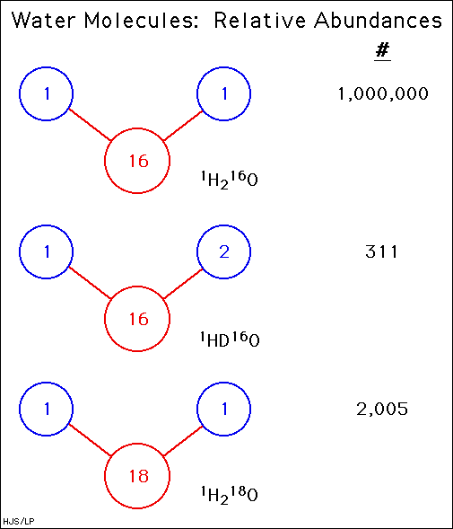
Key measurement: Stable water isotopes

Slide 21
Stable water isotopes
moles of heavy water
moles of light water
Isotopic ratios are usually written using the delta notation.

Slide 22
LIG measurements from Antarctic ice cores:
Masson-Delmotte et al 2011, Clim. Past

Slide 23
Data on the LIG in Antarctic ice cores.
It is telling us something sbout past Antarctic ice sheet changes…
but, what?
Masson-Delmotte et al 2011, Clim. Past

Slide 24
Our isotope (climate model) simulations:
A fairly brutal approach: Orographic/ ice sheet configurations: (a) a modern WAIS configuration, (b) the WAIS flattened, (c) the WAIS removed and replaced with a new region of ocean. Holloway et al. 2016.
(We can run a few tens of simulations on supercomputers; but not 1000s.)

Slide 25
δ18O anomalies for 128 ky. Holloway et al. 2016.

Slide 26
Reducing sea ice around Antarctica; results:
Figure: (a) δ18O anomalies for 128 000 yBP. (b) September sea ice concentration fraction. Black contour signifies the simulated 15 % September sea ice concentration threshold. Blue contour signifies 1978-2013 satellite observations. Holloway et al 2016.

Slide 27
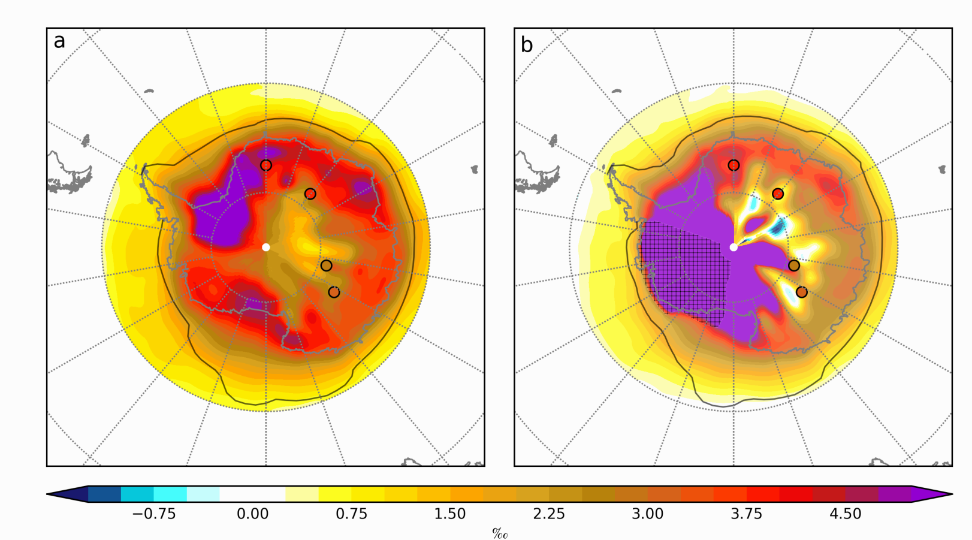
Reducing sea ice AND the West Antarctic Ice Sheet; results:
Figure: δ18O anomalies for 128 000 yBP. (a) With and (b) without WAIS. Holloway et al 2016.

Slide 28
Reducing sea ice AND the West Antarctic Ice Sheet; more results:
Figure: Model-data δ18O match at ice core sites. (a) With and (b) without WAIS.

Slide 29
Outline:
Using the past to constrain future global sea level (GSL) change.
Polar ice cores: well dated evidence of GSL changes?
Applying emulator-based techniques.
Future work.

Slide 30
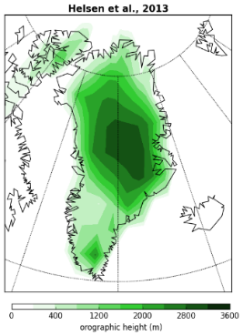
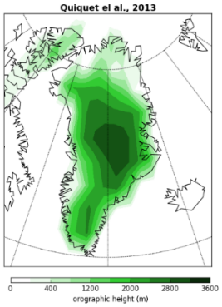
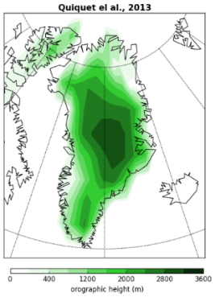
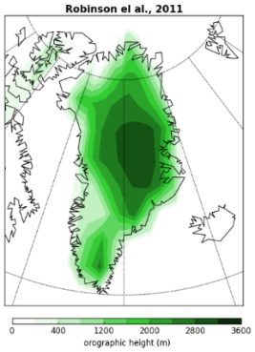
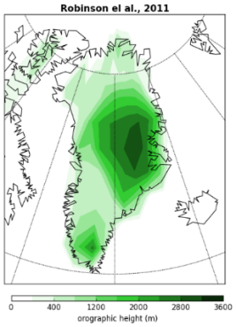
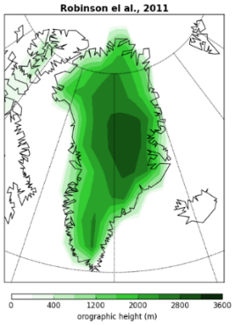
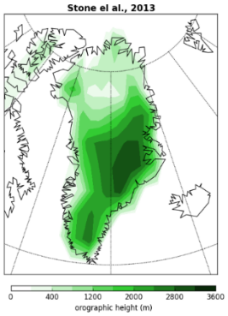
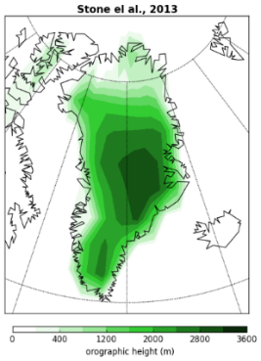
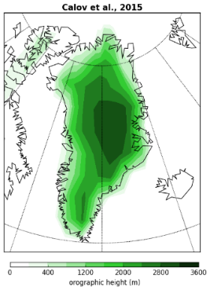
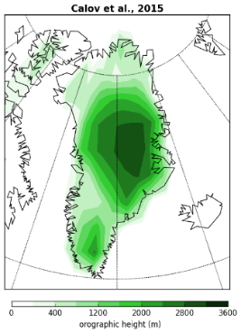
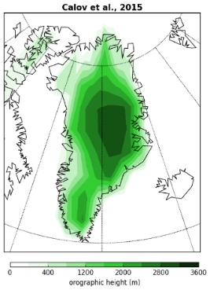
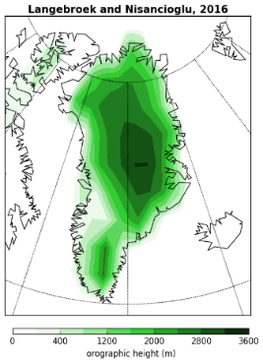
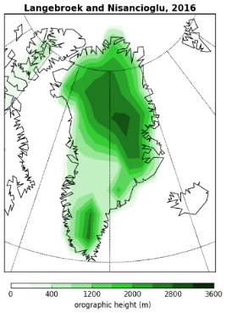
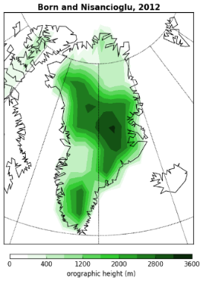
A wide range of LIG GIS morphologies have been proposed by different ISMs.
Central Greenland remained ice covered in all these studies, and melting mainly happened either in the southwest (e.g. Langebroek and Nisancioglu, 2016), or the north (e.g Stone et al., 2013), or both (e.g. Born and Nisancioglu, 2012).
To attempt to take into account this uncertainty on the GIS morphology, we have gathered fourteen different LIG GIS morphologies:

Slide 31
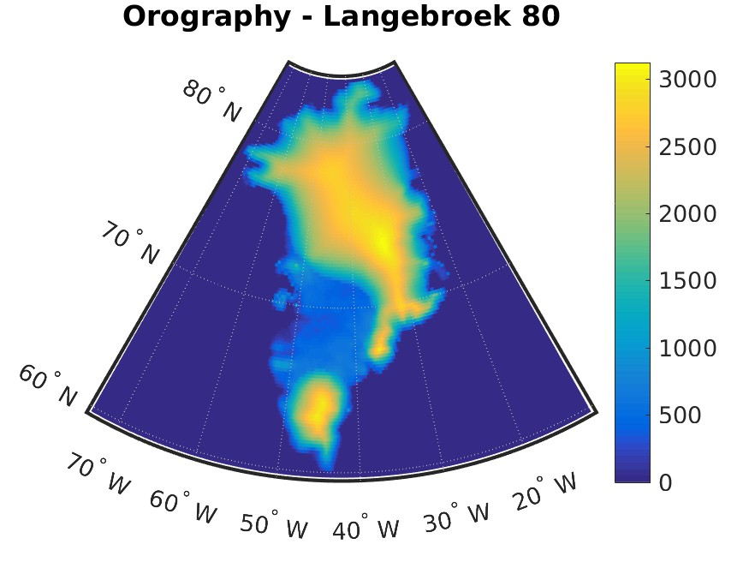
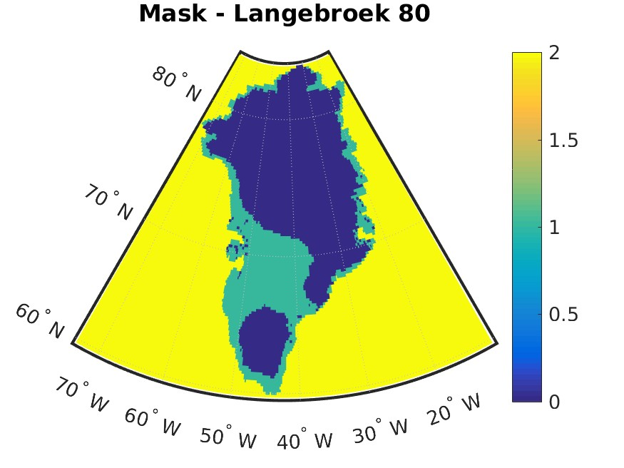
Each reconstruction comes with orography (surface height) and sea-land-ice mask.
Regridding is carried out through cubic splines. A latitude-longitude uniform grid is used, with 0.2◦ angular gridspace in both directions.

Slide 32
Problem in regridding
At latitude ϕ, the distance on Earth’s surface corresponding to 0.2◦ in the East-West direction is smaller by a factor cos ϕ than the distance corresponding to 0.2◦ in the North-South direction. Thus, a uniform longitude-latitude grid turns into a highly non-uniform grid on Earth’s surface. This yields great distortion in the regridded files when spline interpolation is used, especially at high latitudes.
Solution
Interpolation is carried out on new coordinates, obtained by projecting old coordinates onto a plane tangent to the Earth. The point of tangency locates at coordinates 72◦N 40◦W, in the middle of Greenland.

Slide 33
Principal Components to Generate New Shapes:
Each of the 14 original shapes is treated as a vector with p variables, one for each location (p = 38,308). Hence, Principal Component Analysis (PCA) is applied to detect regions displaying mayor orography variability.
This yields 13 Principal Components, used as “building blocks” to generate new synthetic orographies.
Note: Rather than Euclidean scalar product on vectors of R^{p} (i.e. on shapes), a weighted scalar product is used to account for the uneven distribution of the p locations on Greenland, caused by Earth’s sphericity.

Slide 34
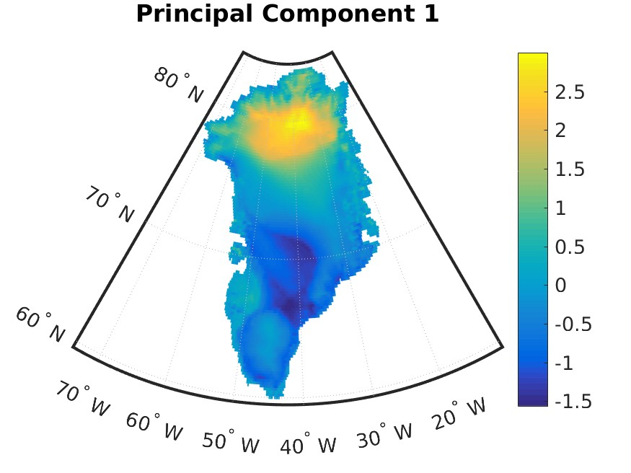
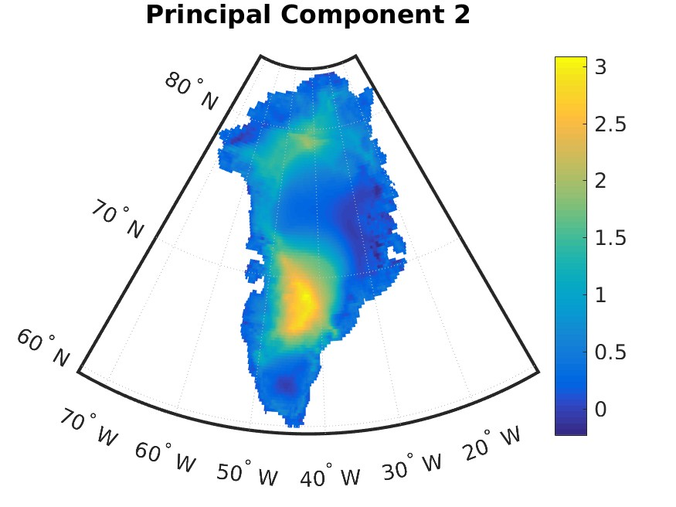
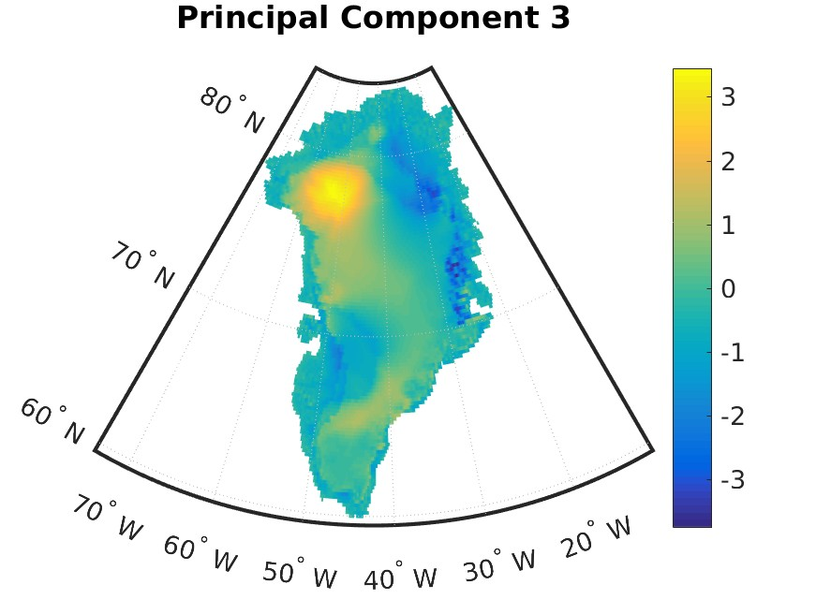
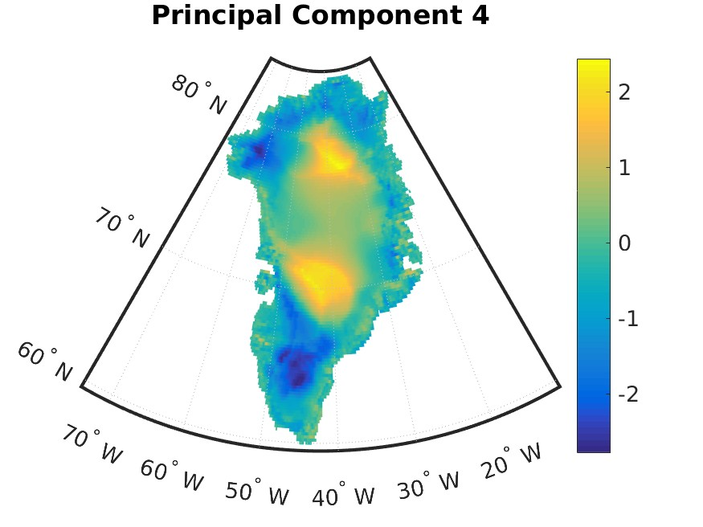
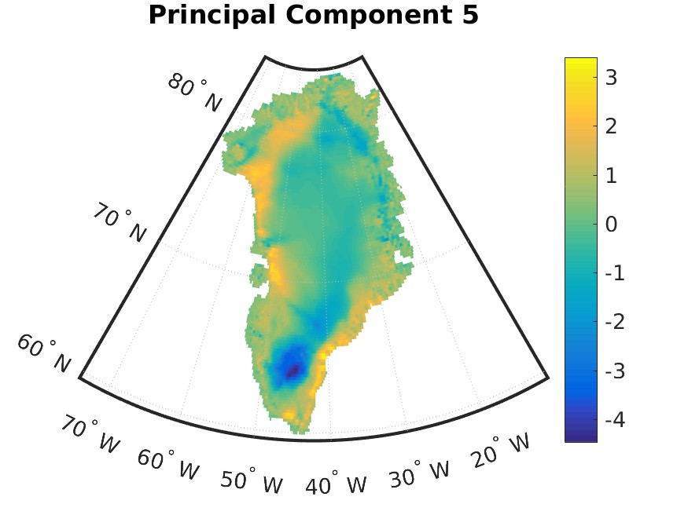
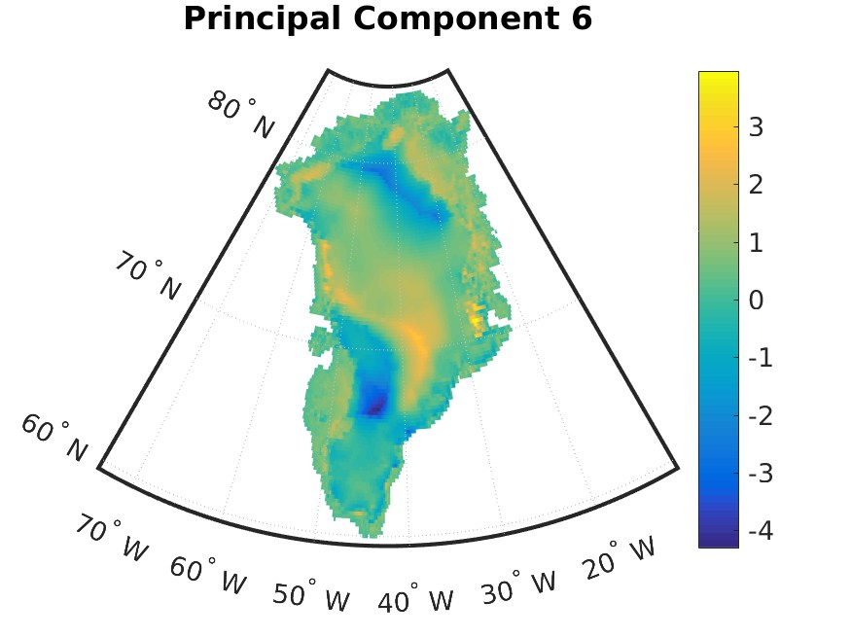
Principal Components

Slide 35
Generation of Synthetic Orographies:
64 new synthetic orographies are generated by taking linear combina- tions of the first 8 PCs.
Coefficients are chosen so as to cover the space spanned by the PCs “as uniformly as possible”. This is achieved in two steps:
generating a Halton quasi-random sequence of 64 points in the 8-dimensional unitary hypercube
applying Normal inverse cumulative distribution function to them and rescaling by standard deviation of each component.
Note: Occasionally, reconstructed surface height may be lower than Green- land bedrock. To avoid that, the maximum between each reconstructed orography and one of the bedrock original reconstructions is considered.

Slide 36
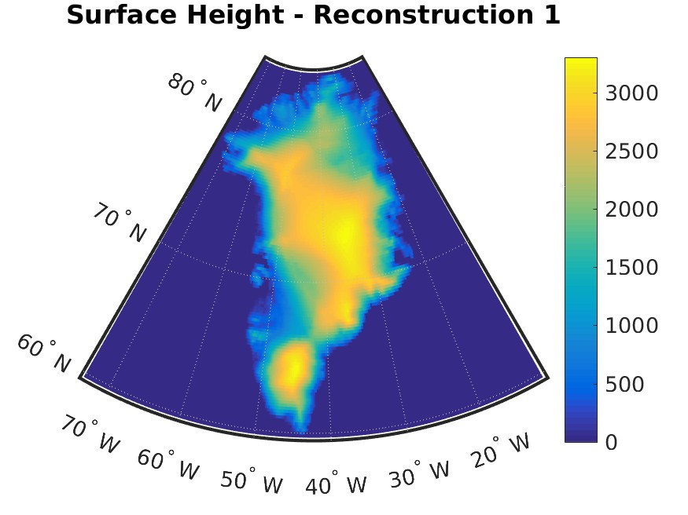
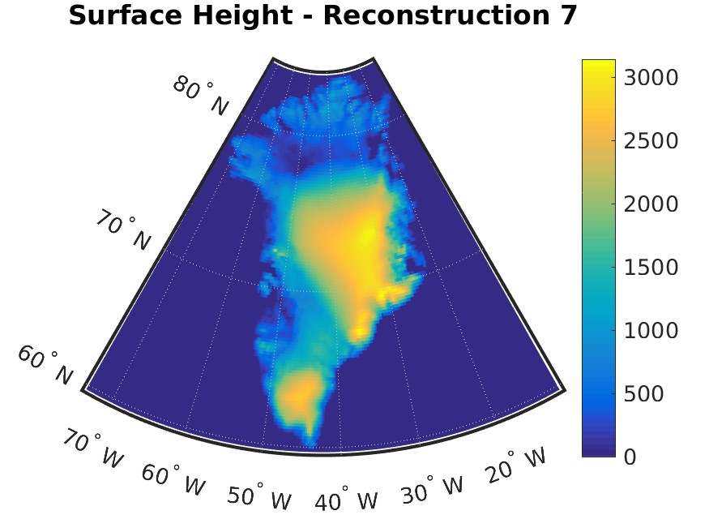
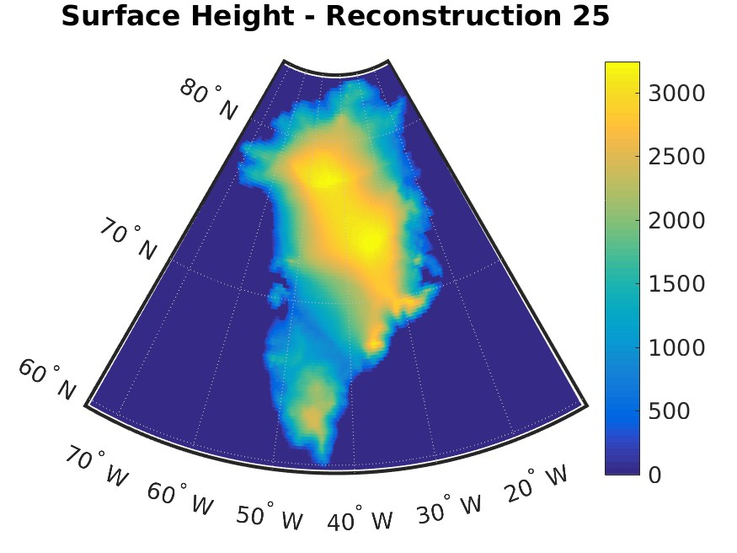
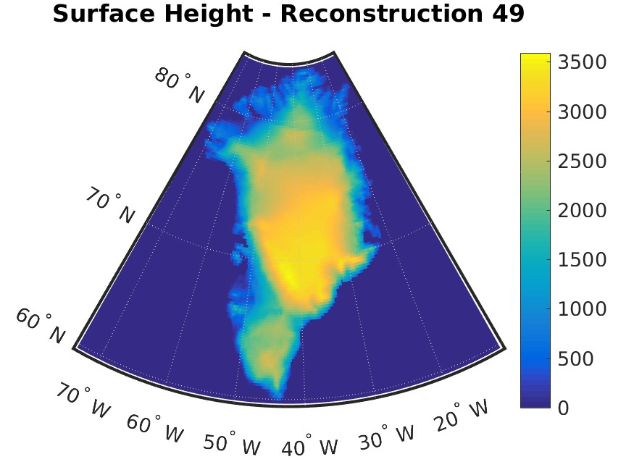

Slide 37
Mask generation:
The mask generation process proved more troublesome, since it could not be carried out through the same approach. Instead, the mask corresponding to a synthetic orography was generated through the following two steps:
for each Greenland location, decide whether ice is present or not by comparing reconstructed height to height and ice presence of the 14 original reconstructions for that location
smooth the mask by accounting for percentage of ice in a circle of 25km around each location.

Slide 38
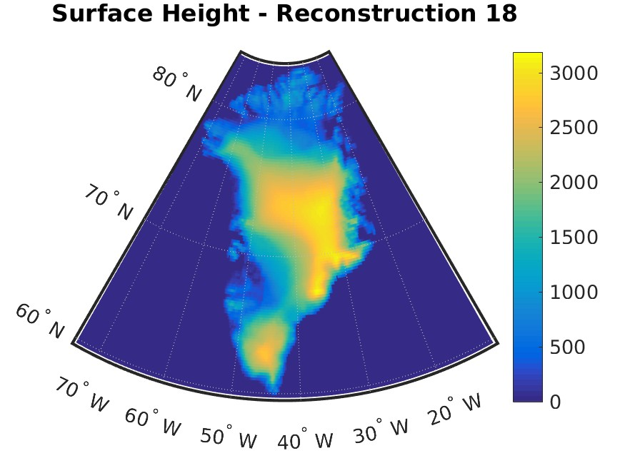
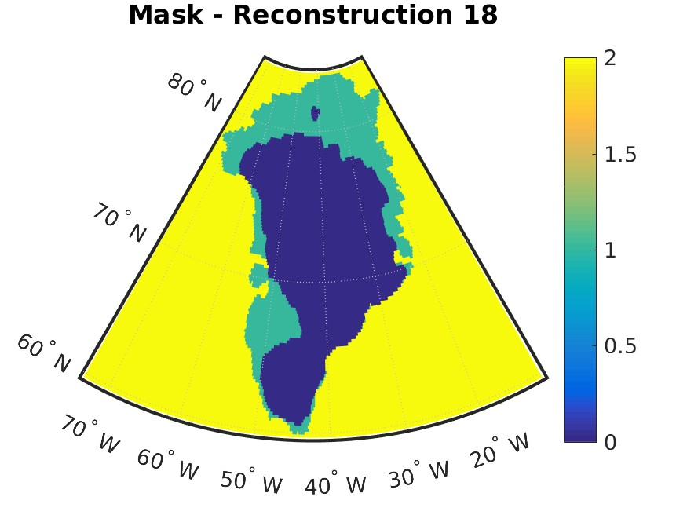
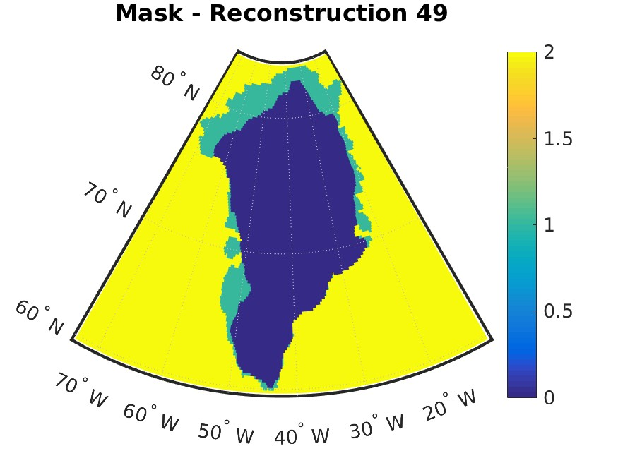

Slide 39
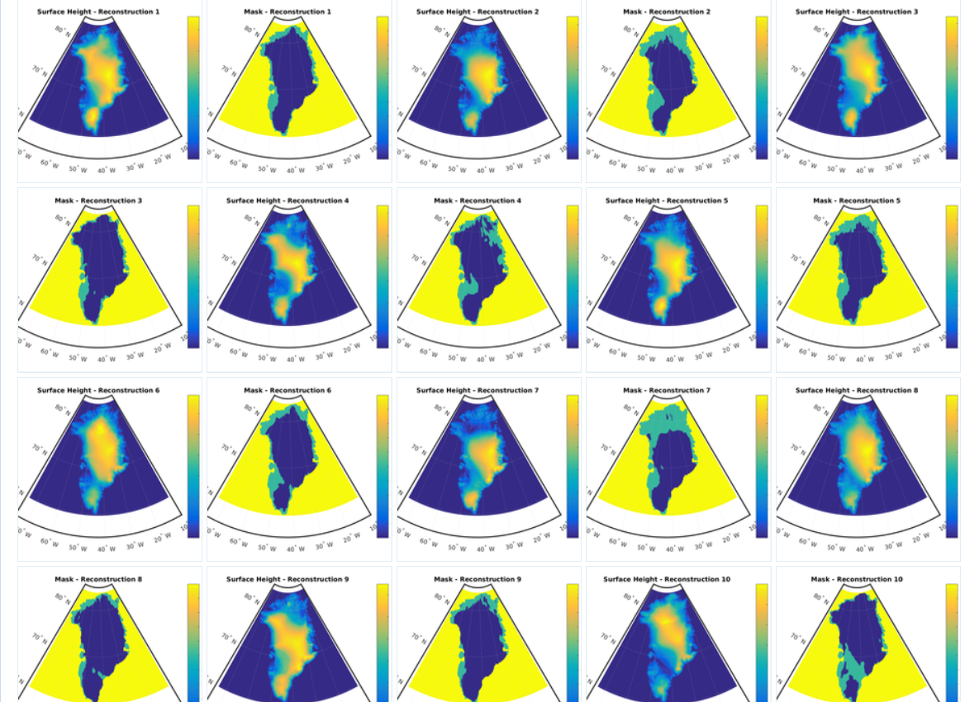
64 GIS morphologies…

Slide 40
Applying emulator-based techniques to the problem.
-These simulations are now running (Irene)
-In the meantime, a few preliminary results from sea ice reduction simulations, focused on Greenland.

Slide 41
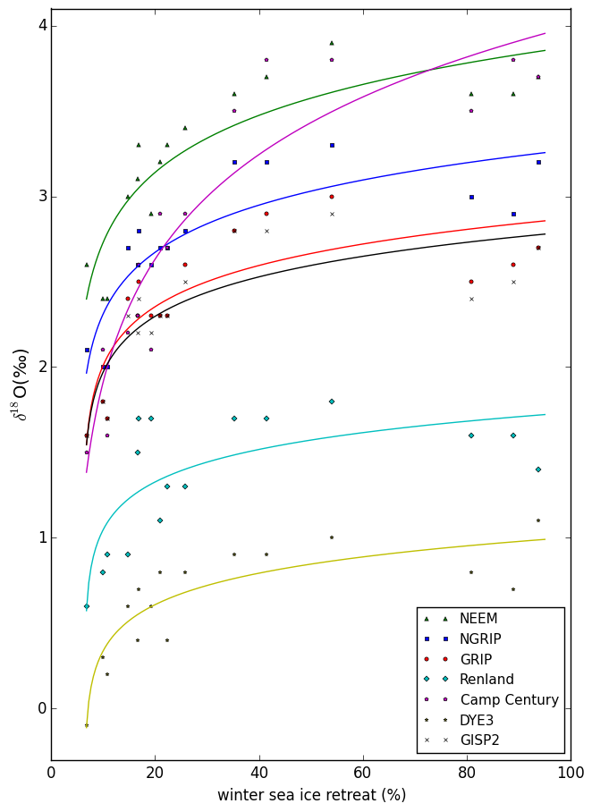
HadCM3 simulations of a forced retreat of sea ice do reproduce the observed δ¹⁸O anomalies at NEEM (3.6 ‰), NGRIP (3.1‰), Camp Century (2.5‰) and GISP2 (2.7‰) sites.

Slide 42
Summary:
Using the past to constrain future global sea level (GSL) change.
Polar ice cores: well dated evidence of GSL changes?
Applying emulator-based techniques.
Future work:
-ice sheet morphology change simulations (and emulation!)
-the calculation of uncertainty in the model results and in the measurements.
-and GSL implications, including rates of change
..and partitioning GSL contributions between Greenland and Antarctica.

